Slide 1
Working with Sequential Data
Alexey Zaytsev
Rodrigo Rivera
January, 2020

Slide 2
Stating the Problem

Slide 3
Stating the Problem
Say you’re helping a friend who wants to buy a house. She was quoted $400,000 for a 2000 sq ft house (185 meters). Is this a good price or not?
Area (sq ft) (x) | Price (y)
2,104 | 399,900
1,600 | 329,900
2,400 | 369,000

Slide 4
Stating the Problem
Say you’re helping a friend who wants to buy a house. She was quoted $400,000 for a 2000 sq ft house (185 meters). Is this a good price or not?
Area (sq ft) (x) | Price (y)
2,104 | 399,900
1,600 | 329,900
2,400 | 369,000

Slide 5
Stating the Problem
Say you’re helping a friend who wants to buy a house. She was quoted $400,000 for a 2000 sq ft house (185 meters). Is this a good price or not?
Area (sq ft) (x) | Price (y)
2,104 | 399,900
1,600 | 329,900
2,400 | 369,000
Multiplying 2,000 sq ft by 180 gives us $360,000.
Calculating the prediction is simple multiplication.

Slide 6
Stating the Problem
Say you’re helping a friend who wants to buy a house. She was quoted $400,000 for a 2000 sq ft house (185 meters). Is this a good price or not?
Area (sq ft) (x) | Price (y)
2,104 | 399,900
1,600 | 329,900
2,400 | 369,000
Multiplying 2,000 sq ft by 180 gives us $360,000.
Calculating the prediction is simple multiplication.

Slide 7
Stating the Problem
Say you’re helping a friend who wants to buy a house. She was quoted $400,000 for a 2000 sq ft house (185 meters). Is this a good price or not?
Take an input
Do a calculation
Give an output
Area (sq ft) (x) | Price (y)
2,104 | 399,900
1,600 | 329,900
2,400 | 369,000
Multiplying 2,000 sq ft by 180 gives us $360,000.
Calculating the prediction is simple multiplication.

Slide 8
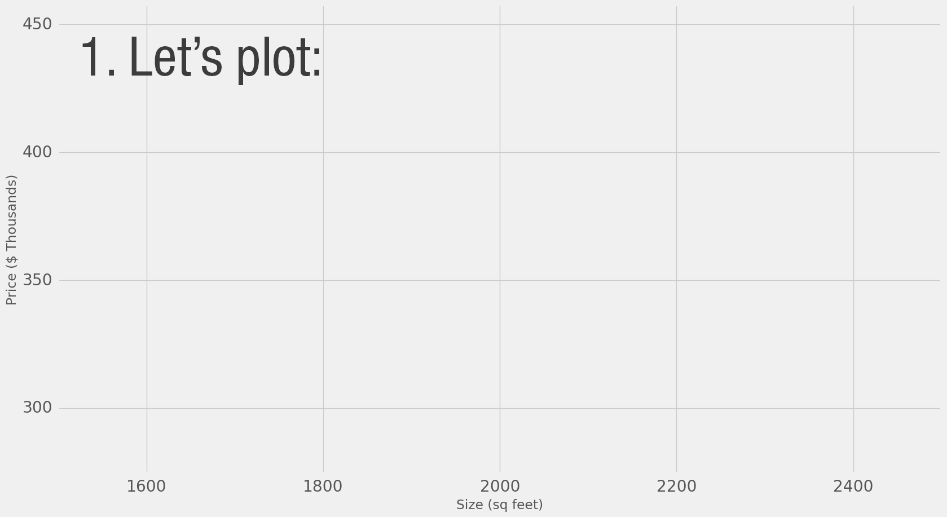
Stating the Problem
Say you’re helping a friend who wants to buy a house. She was quoted $400,000 for a 2000 sq ft house (185 meters). Is this a good price or not?
Area (sq ft) (x) | Price (y)
2,104 | 399,900
1,600 | 329,900
2,400 | 369,000

Slide 9
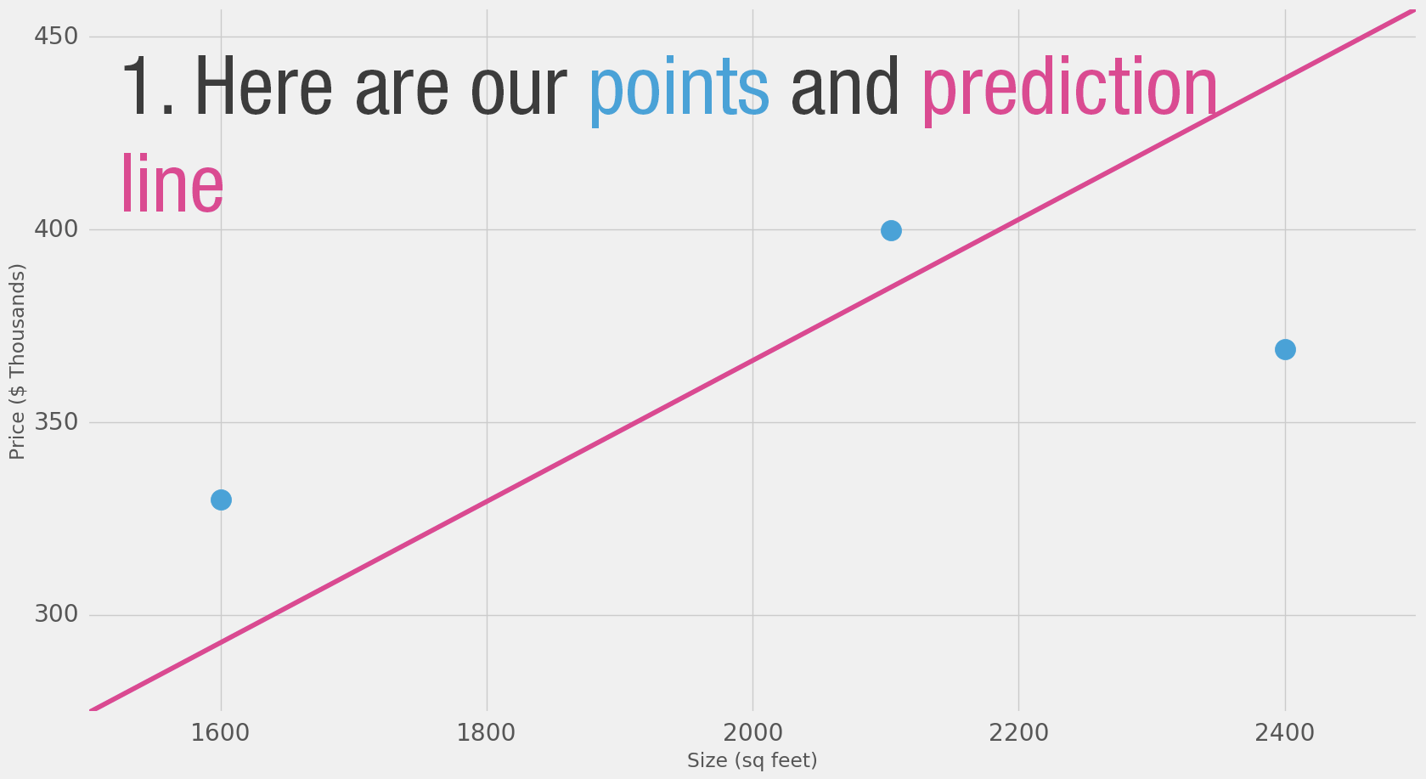
Stating the Problem
Say you’re helping a friend who wants to buy a house. She was quoted $400,000 for a 2000 sq ft house (185 meters). Is this a good price or not?
If we apply our model to the three data points we have, how good of a job would it do?
Area (sq ft) (x) | Price (y)
2,104 | 399,900
1,600 | 329,900
2,400 | 369,000

Slide 10
Stating the Problem
Say you’re helping a friend who wants to buy a house. She was quoted $400,000 for a 2000 sq ft house (185 meters). Is this a good price or not?
If we apply our model to the three data points we have, how good of a job would it do?
Area (x) | Price ($1000) (y_) | Prediction (y) | y_-y | (y_-y)²
2,104 | 399.9 | 379 | 21 | 449
1,600 | 329.9 | 288 | 42 | 1756
2,400 | 369 | 432 | -63 | 3969
Average: | 2,058

Slide 11
Stating the Problem
Say you’re helping a friend who wants to buy a house. She was quoted $400,000 for a 2000 sq ft house (185 meters). Is this a good price or not?
If we apply our model to the three data points we have, how good of a job would it do?
Area (x) | Price ($1000) (y_) | Prediction (y) | y_-y | (y_-y)²
2,104 | 399.9 | 379 | 21 | 449
1,600 | 329.9 | 288 | 42 | 1756
2,400 | 369 | 432 | -63 | 3969
Average: | 2,058
actual price value
the predicted price value
the difference between them

Slide 12
Stating the Problem
Say you’re helping a friend who wants to buy a house. She was quoted $400,000 for a 2000 sq ft house (185 meters). Is this a good price or not?
If we apply our model to the three data points we have, how good of a job would it do?
Area (x) | Price ($1000) (y_) | Prediction (y) | y_-y | (y_-y)²
2,104 | 399.9 | 379 | 21 | 449
1,600 | 329.9 | 288 | 42 | 1756
2,400 | 369 | 432 | -63 | 3969
Average: | 2,058
actual price value
the predicted price value
the difference between them
Average these differences to have a number that tells how much error there is in this prediction model.
The problem is, the 3rd row has -63 as its value.

Slide 13
Stating the Problem
Say you’re helping a friend who wants to buy a house. She was quoted $400,000 for a 2000 sq ft house (185 meters). Is this a good price or not?
If we apply our model to the three data points we have, how good of a job would it do?
Area (x) | Price ($1000) (y_) | Prediction (y) | y_-y | (y_-y)²
2,104 | 399.9 | 379 | 21 | 449
1,600 | 329.9 | 288 | 42 | 1756
2,400 | 369 | 432 | -63 | 3969
Average: | 2,058
actual price value, the predicted price value, and the difference between them
Average these differences to have a number that tells how much error there is in this prediction model.
The problem is, the 3rd row has -63 as its value.
To deal with the negative value, square the error

Slide 14
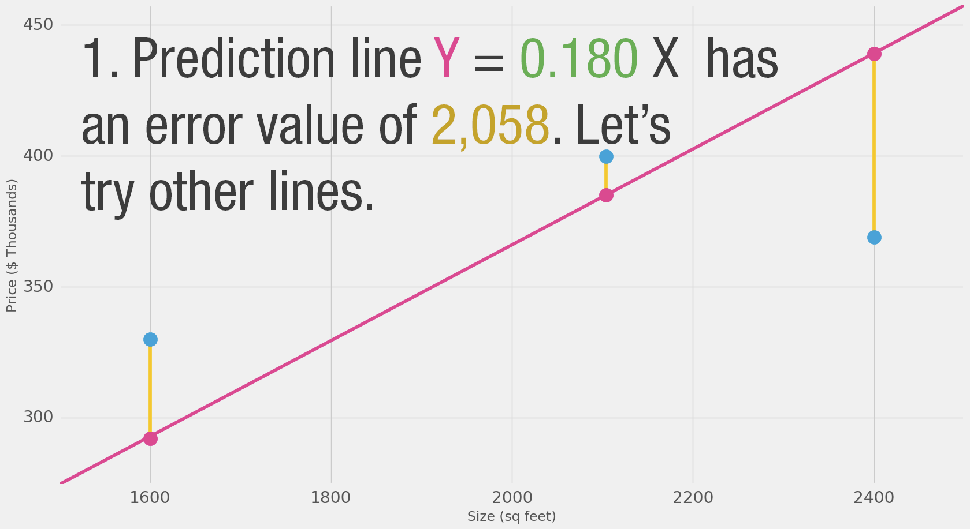
Stating the Problem
Say you’re helping a friend who wants to buy a house. She was quoted $400,000 for a 2000 sq ft house (185 meters). Is this a good price or not?
If we apply our model to the three data points we have, how good of a job would it do?
Area (x) | Price ($1000) (y_) | Prediction (y) | y_-y | (y_-y)²
2,104 | 399.9 | 379 | 21 | 449
1,600 | 329.9 | 288 | 42 | 1756
2,400 | 369 | 432 | -63 | 3969
Average: | 2,058
Error is measured as the average of the errors for each point in the data set.
For each point, the error is measured by the difference between the actual value and the predicted value, raised to the power of 2.
This is called MEAN SQUARED ERROR.
This will be our loss function (also, cost function).

Slide 15
Stating the Problem
Say you’re helping a friend who wants to buy a house. She was quoted $400,000 for a 2000 sq ft house (185 meters). Is this a good price or not?
If we apply our model to the three data points we have, how good of a job would it do?
Area (x) | Price ($1000) (y_) | Prediction (y) | y_-y | (y_-y)²
2,104 | 399.9 | 379 | 21 | 449
1,600 | 329.9 | 288 | 42 | 1756
2,400 | 369 | 432 | -63 | 3969
Average: | 2,058
We can't improve much on the model by varying the weight any more.
But if we add a bias we can find values that improve the model.

Slide 16
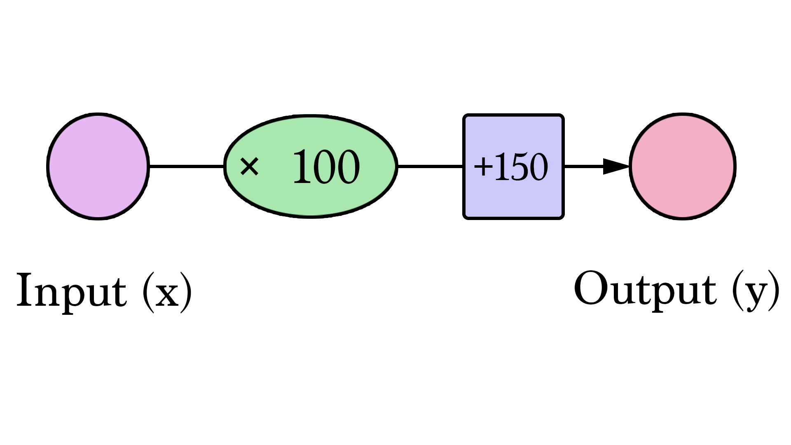
Stating the Problem
Say you’re helping a friend who wants to buy a house. She was quoted $400,000 for a 2000 sq ft house (185 meters). Is this a good price or not?
If we apply our model to the three data points we have, how good of a job would it do?
Area (x) | Price ($1000) (y_) | Prediction (y) | y_-y | (y_-y)²
2,104 | 399.9 | 379 | 21 | 449
1,600 | 329.9 | 288 | 42 | 1756
2,400 | 369 | 432 | -63 | 3969
Average: | 2,058
Our lines can better approximate our values now that we have this b value added to the line formula. In this context, we call it a “bias”.
We can't improve much on the model by varying the weight any more.
But if we add a bias we can find values that improve the model.

Slide 17
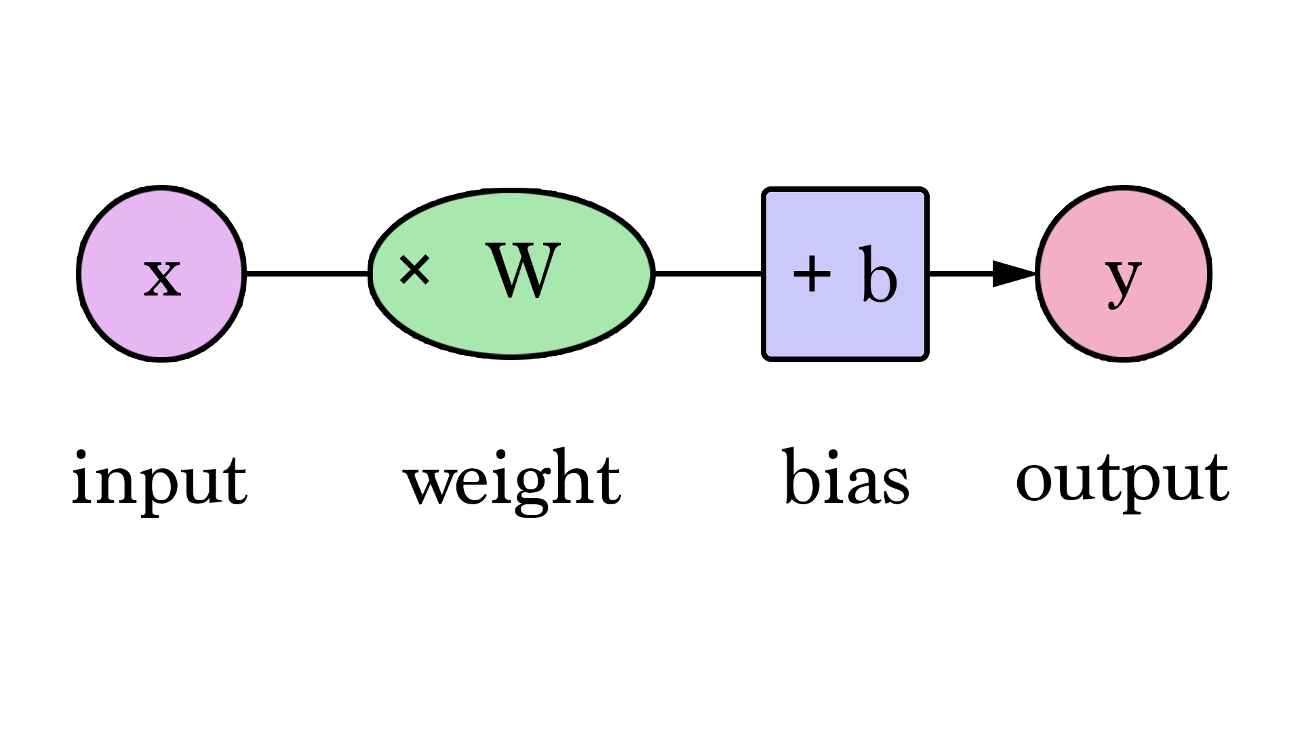
Stating the Problem
Say you’re helping a friend who wants to buy a house. She was quoted $400,000 for a 2000 sq ft house (185 meters). Is this a good price or not?
If we apply our model to the three data points we have, how good of a job would it do?
Area (x) | Price ($1000) (y_) | Prediction (y) | y_-y | (y_-y)²
2,104 | 399.9 | 379 | 21 | 449
1,600 | 329.9 | 288 | 42 | 1756
2,400 | 369 | 432 | -63 | 3969
Average: | 2,058
Our lines can better approximate our values now that we have this b value added to the line formula. In this context, we call it a “bias”.
W and b are values we find during the training process.
X is the input we plug into the formula (area in sq ft in our example).
Y is the predicted price.

Slide 18
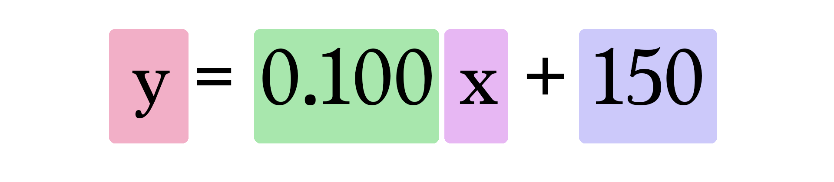
Stating the Problem
Say you’re helping a friend who wants to buy a house. She was quoted $400,000 for a 2000 sq ft house (185 meters). Is this a good price or not?
If we apply our model to the three data points we have, how good of a job would it do?
Area (x) | Price ($1000) (y_) | Prediction (y) | y_-y | (y_-y)²
2,104 | 399.9 | 379 | 21 | 449
1,600 | 329.9 | 288 | 42 | 1756
2,400 | 369 | 432 | -63 | 3969
Average: | 2,058
Our lines can better approximate our values now that we have this b value added to the line formula. In this context, we call it a “bias”.
W and b are values we find during the training process.
X is the input we plug into the formula (area in sq ft in our example).
Y is the predicted price.
Current model calculates predictions by plugging in the area of house as x in this formula

Slide 19
Stating the Problem
Say you’re helping a friend who wants to buy a house. She was quoted $400,000 for a 2000 sq ft house (185 meters). Is this a good price or not?
If we apply our model to the three data points we have, how good of a job would it do?
Area (x) | Price ($1000) (y_) | Prediction (y) | y_-y | (y_-y)²
2,104 | 399.9 | 379 | 21 | 449
1,600 | 329.9 | 288 | 42 | 1756
2,400 | 369 | 432 | -63 | 3969
Average: | 2,058
Our lines can better approximate our values now that we have this b value added to the line formula. In this context, we call it a “bias”.
How can we do better?
Current model calculates predictions by plugging in the area of house as x in this formula

Slide 20
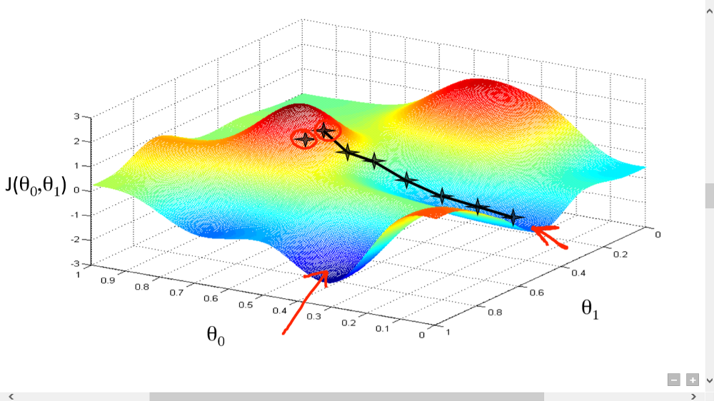
Finding the Optimum

Slide 21
Finding the Optimum
Gradient descent algorithm is an iterative process that takes us to the minimum of a function

Slide 22
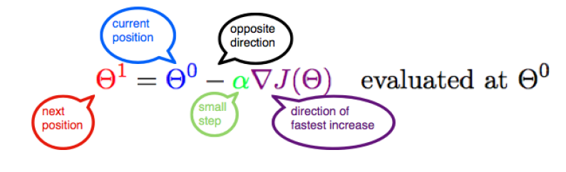
Finding the Optimum
Gradient descent algorithm is an iterative process that takes us to the minimum of a function

Slide 23
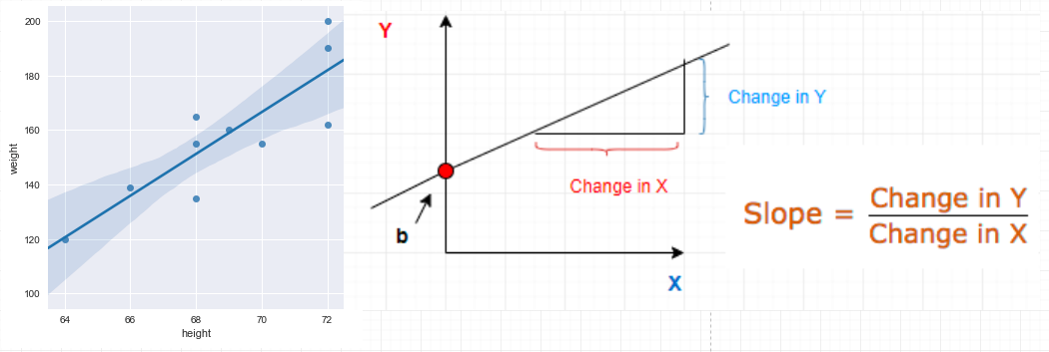
Finding the Optimum
Gradient descent algorithm is an iterative process that takes us to the minimum of a function
Data points in a 2 D space.
We are trying to predict some kind of relationship between these quantities so that we could predict the weight of some new students afterwards.
Draw an arbitrary line in space that passes through some of these data points.
The equation of this straight line would be
Y = mX + b
where m is the slope
and b is its intercept on the Y-axis

Slide 24
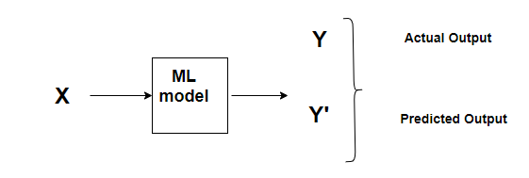
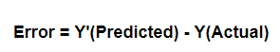
Finding the Optimum

Slide 25
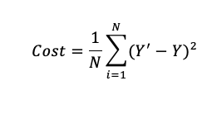
Finding the Optimum
A Cost Function/Loss Function evaluates the performance of our Machine Learning Algorithm.
The Loss function computes the error for a single training example
The Cost function is the average of the loss functions for all the training examples.
The goal is to minimize the Cost Function.

Slide 26
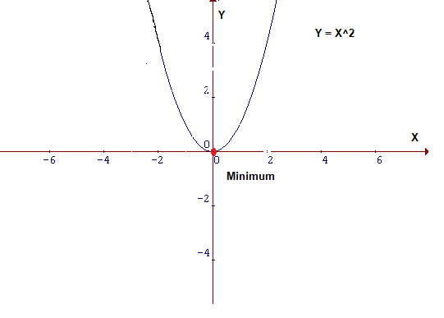
Finding the Optimum
How do we actually minimize any function?
If we look carefully, our Cost function is of the form Y = X² . In a Cartesian coordinate system, this is an equation for a parabola and can be graphically represented as :
Find the value of X that produces the lowest value of Y which is the red dot.
Quite easy to locate the minima in a 2D graph
For higher dimensions: Gradient Descent.

Slide 27
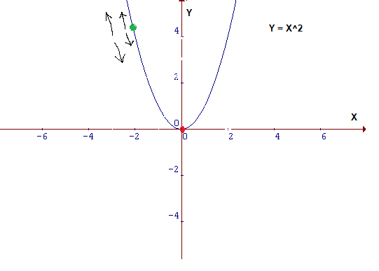
Intuition
Currently at the ‘green’ dot. aim is to reach the minimum i.e the ‘red’ dot, but from your position, you are unable to view it.
Possible actions would be:
Go upward or downward
Take a bigger step or a little step

Slide 28
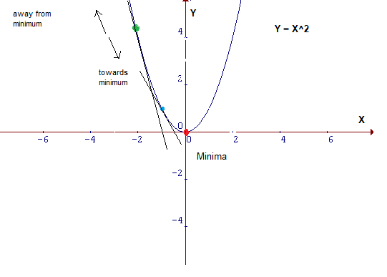
Intuition
Draw a tangent at the green point
If moving upwards, then it is moving away from the minima and vice versa.
The tangent gives a sense of the steepness of the slope.

Slide 29
Intuition
Draw a tangent at the green point
If moving upwards, then it is moving away from the minima and vice versa.
The tangent gives a sense of the steepness of the slope.
The slope at the blue point is less steep than that at the green point
It will take much smaller steps to reach the minimum from the blue point than from the green point.

Slide 30
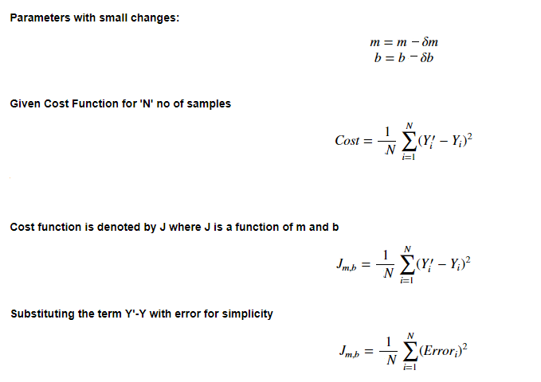
The cost function
In y = mX+b, ‘m’ and ‘b’ are its parameters.
During the training process, there will be a small change in their values.
Let that small change be denoted by δ.
The value of parameters will be updated as m=m-δm and b=b-δb respectively.
Find those values of m and b in y = mx+b , for which the error is minimum i.e. values which minimize the cost function.

Slide 31
Learning rate
This size of steps taken to reach the minimum or bottom is called Learning Rate.
Cover more area with larger steps/higher learning rate
But are at the risk of overshooting the minima.
Small steps/smaller learning rates will consume a lot of time to reach the lowest point.

Slide 32
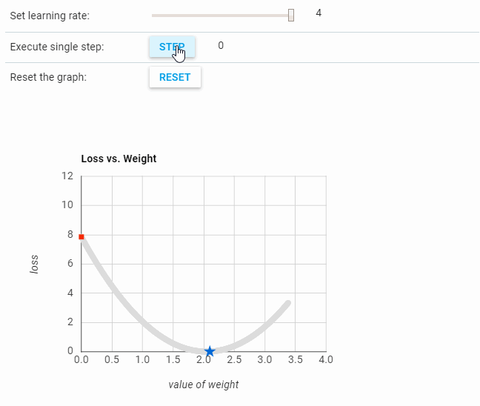
Learning rate
This size of steps taken to reach the minimum or bottom is called Learning Rate.
Cover more area with larger steps/higher learning rate
But are at the risk of overshooting the minima.
Small steps/smaller learning rates will consume a lot of time to reach the lowest point.

Slide 33
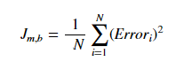
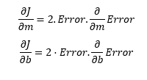
Calculating gradient descent
Find the derivative of the Cost Function w.r.t to both ‘m’ and ‘b’.
For simplicity, get rid of the summation sign.
Look at each error one at a time

Slide 34
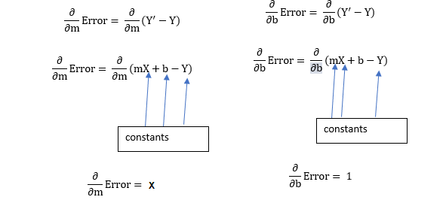
Calculating gradient descent
Find the derivative of the Cost Function w.r.t to both ‘m’ and ‘b’.
For simplicity, get rid of the summation sign.
Look at each error one at a time

Slide 35
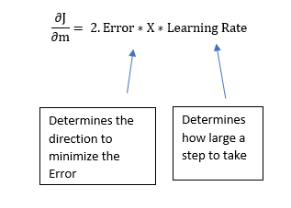
Calculating gradient descent
Find the derivative of the Cost Function w.r.t to both ‘m’ and ‘b’.
For simplicity, let us get rid of the summation sign.
Look at each error one at a time
Plugging the values back in the cost function and multiplying it with the learning rate
The 2 in this equation isn’t that significant since it just says that we have a learning rate twice as big or half as big

Slide 36
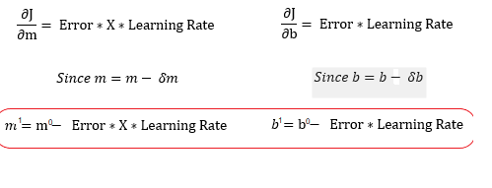
Calculating gradient descent
Two simple equations which represent the equations for Gradient Descent.
m¹,b¹ = next position parameters; m⁰,b⁰ = current position parameters
To solve for the gradient, iterate through all data points using new m and b values
Compute the partial derivatives.
This new gradient tells us the slope of our cost function at our current position and the direction we should move to update our parameters.
The size of our update is controlled by the learning rate.

Slide 37
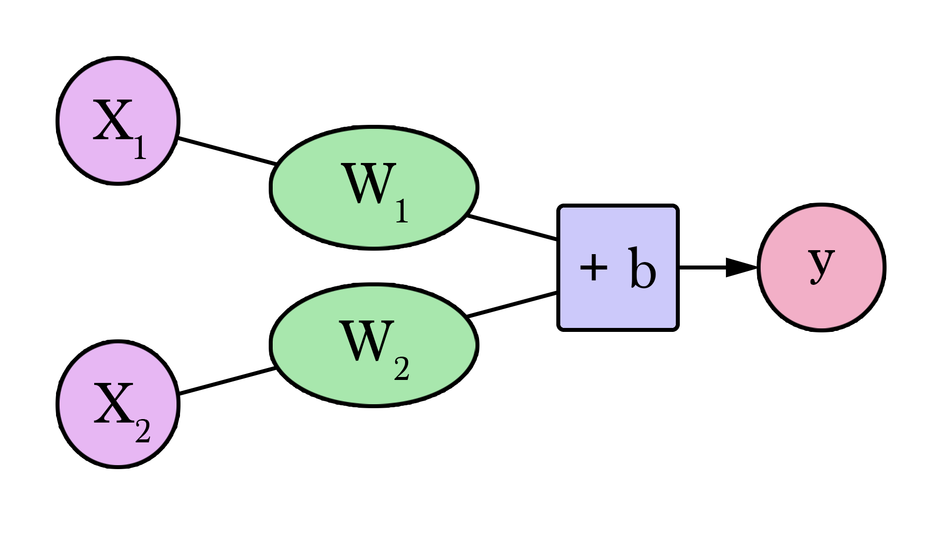
Going back to our NN
Area (sq ft) (x1) | Bathrooms (x2) | Price (y)
2,104 | 3 | 399,900
1,600 | 3 | 329,900
2,400 | 3 | 369,000
1,416 | 2 | 232,000
3,000 | 4 | 539,900
1,985 | 4 | 299,900
1,534 | 3 | 314,900
1,427 | 3 | 198,999
1,380 | 3 | 212,000
1,494 | 3 | 242,500

Slide 38
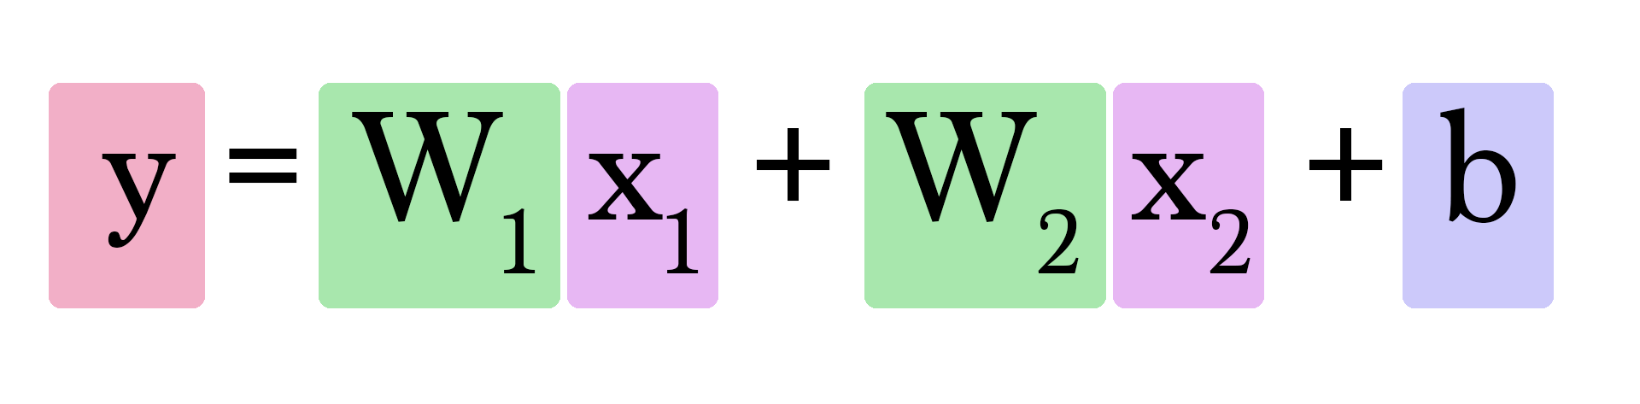
Going back to our NN
Area (sq ft) (x1) | Bathrooms (x2) | Price (y)
2,104 | 3 | 399,900
1,600 | 3 | 329,900
2,400 | 3 | 369,000
1,416 | 2 | 232,000
3,000 | 4 | 539,900
1,985 | 4 | 299,900
1,534 | 3 | 314,900
1,427 | 3 | 198,999
1,380 | 3 | 212,000
1,494 | 3 | 242,500

Slide 39
Going back to our NN
Area (sq ft) (x1) | Bathrooms (x2) | Price (y)
2,104 | 3 | 399,900
1,600 | 3 | 329,900
2,400 | 3 | 369,000
1,416 | 2 | 232,000
3,000 | 4 | 539,900
1,985 | 4 | 299,900
1,534 | 3 | 314,900
1,427 | 3 | 198,999
1,380 | 3 | 212,000
1,494 | 3 | 242,500
To find the right weights, we use again gradient descent!

Slide 40
To transform the network into a classification network is to have it output two values
One for each class (“good” and “bad”).
Pass these values through an operation called softmax.
The output of softmax is the probability of each class.
Example, output is 2 for “good” and 4 for “bad”,
If we feed [2, 4] to softmax, it will return [0.11, 0.88] as the output.
Which translates the values to say the network is 88% sure that the inputted value is “bad” and our friend would not like that house.
Softmax takes an array and outputs an array of the same length.
Notice that its outputs are all positive and sum up to 1
Which is useful when we’re outputting a probability value.
Also notice that even though 4 is double 2, its probability is not only double, but is eight times that of 2.
This is a useful property that exaggerates the difference in output thus improving our training process.
Classification
Area (sq ft) (x1) | Bathrooms (x2) | Label (y)
2,104 | 3 | Good
1,600 | 3 | Good
2,400 | 3 | Good
1,416 | 2 | Bad
3,000 | 4 | Bad
1,985 | 4 | Good
1,534 | 3 | Bad
1,427 | 3 | Good
1,380 | 3 | Good
1,494 | 3 | Good

Slide 41
To transform the network into a classification network is to have it output two values
One for each class (“good” and “bad”).
Pass these values through an operation called softmax.
The output of softmax is the probability of each class.
Example, output is 2 for “good” and 4 for “bad”,
If we feed [2, 4] to softmax, it will return [0.11, 0.88] as the output.
Which translates the values to say the network is 88% sure that the inputted value is “bad” and our friend would not like that house.
Softmax takes an array and outputs an array of the same length.
Notice that its outputs are all positive and sum up to 1
Which is useful when we’re outputting a probability value.
Also notice that even though 4 is double 2, its probability is not only double, but is eight times that of 2.
This is a useful property that exaggerates the difference in output thus improving our training process.
Classification
 | output
softmax([ 1 ]) | [ 1 ]
softmax([ 1, 1 ]) | [ 0.5, 0.5 ]
softmax([ 0, 1 ]) | [ 0.26, 0.73 ]
softmax([ 2, 4 ]) | [ 0.11, 0.88 ]
softmax([ 5, 10 ]) | [ 0.007, 0.993 ]
softmax([ -1, 0, 1 ]) | [ 0.09, 0.24, 0.66 ]
softmax([ 1, 2, 4 ]) | [ 0.04, 0.11, 0.84 ]
Softmax extends to any number of inputs.

Slide 42
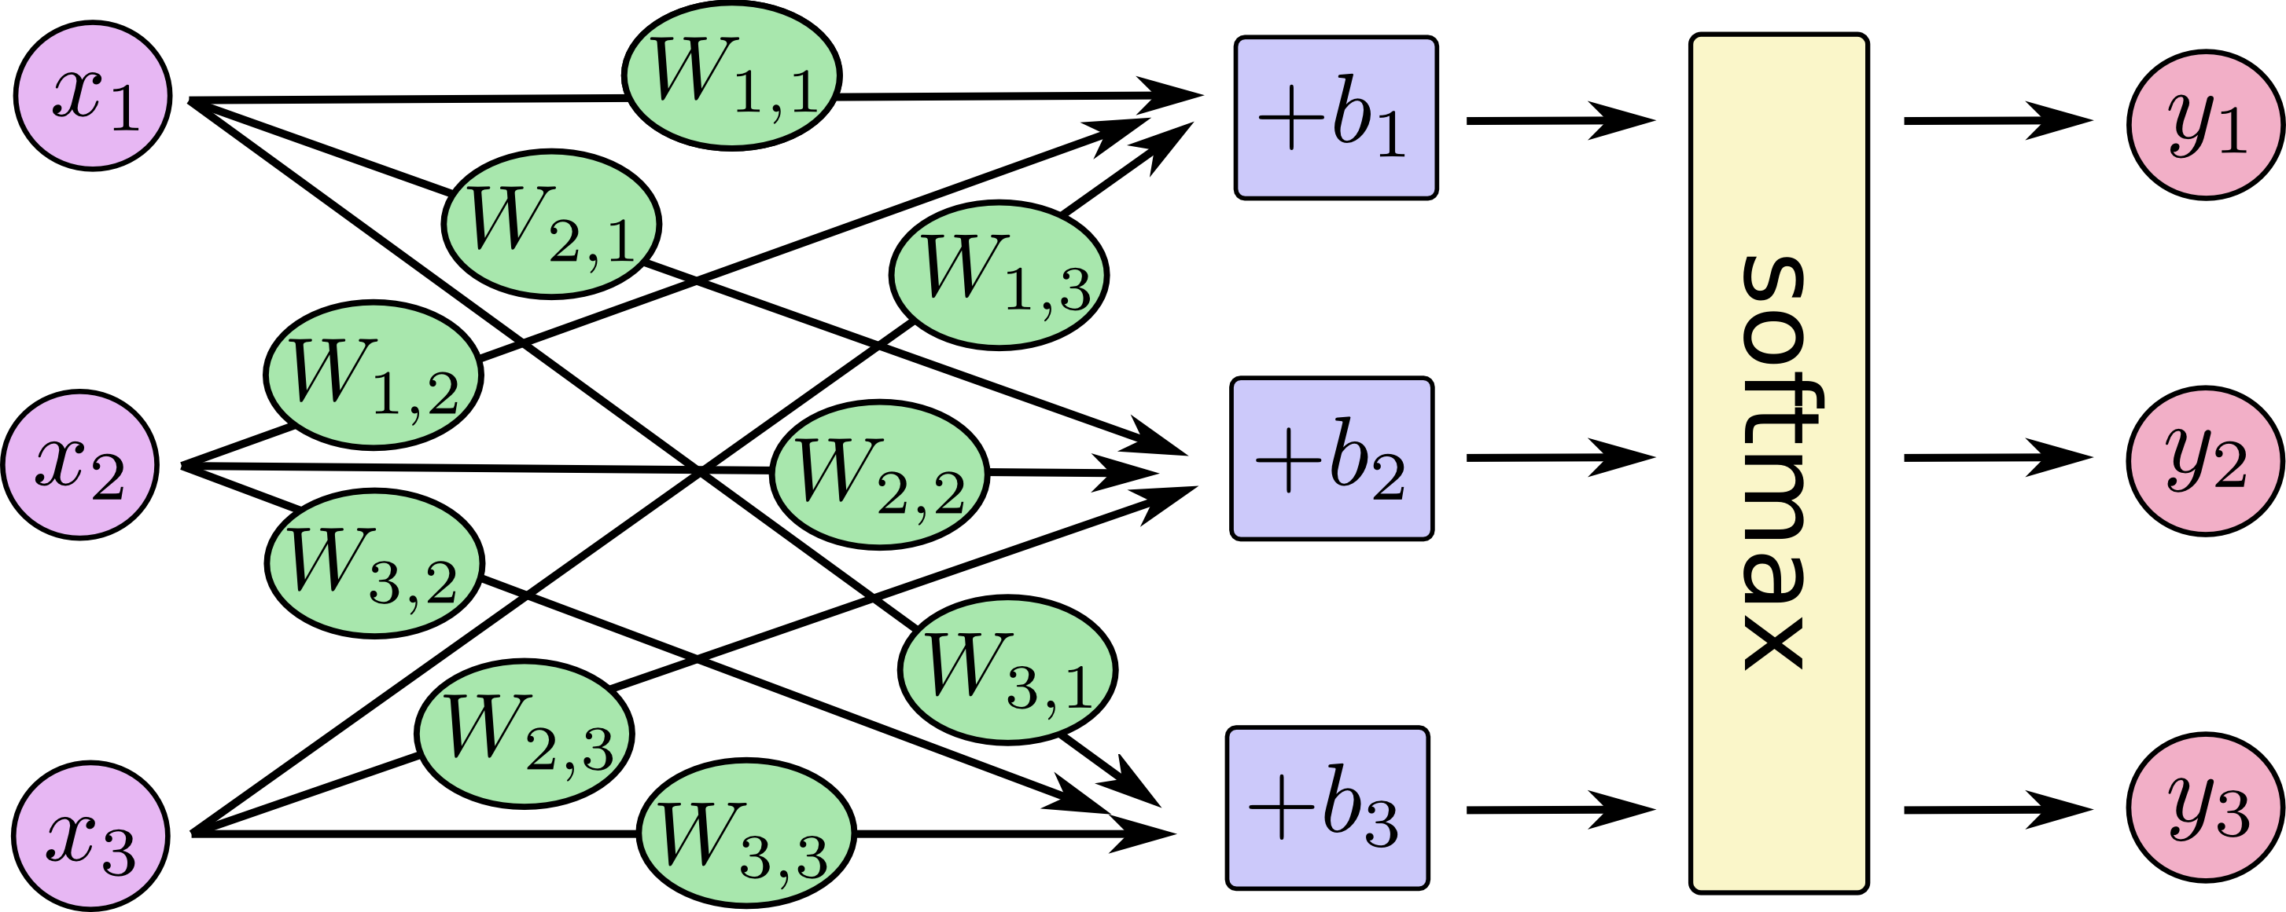
To transform the network into a classification network is to have it output two values
One for each class (“good” and “bad”).
Pass these values through an operation called softmax.
The output of softmax is the probability of each class.
Example, output is 2 for “good” and 4 for “bad”,
If we feed [2, 4] to softmax, it will return [0.11, 0.88] as the output.
Which translates the values to say the network is 88% sure that the inputted value is “bad” and our friend would not like that house.
Softmax takes an array and outputs an array of the same length.
Notice that its outputs are all positive and sum up to 1
Which is useful when we’re outputting a probability value.
Also notice that even though 4 is double 2, its probability is not only double, but is eight times that of 2.
This is a useful property that exaggerates the difference in output thus improving our training process.
Classification

Slide 43
An example with the Titanic dataset
PassengerId | Survived | Pclass | Name | Sex | Age | SibSp | Parch | Ticket | Fare | Cabin | Embarked
1 | 0 | 3 | Braund, Mr. Owen Harris | male | 22.0 | 1 | 0 | A/5 21171 | 7.2500 | NaN | S
2 | 1 | 1 | Cumings, Mrs. John Bradley (Florence Briggs Th… | female | 38.0 | 1 | 0 | PC 17599 | 71.2833 | C85 | C
3 | 1 | 3 | Heikkinen, Miss. Laina | female | 26.0 | 0 | 0 | STON/O2. 3101282 | 7.9250 | NaN | S

Slide 44
An example with the Titanic dataset
Age | Sex | Survived?
22 | 0 | 0
38 | 1 | 1
26 | 1 | 1
… 891 rows total
Only use the sex and age columns as our features, and survival as our label to predict.

Slide 45
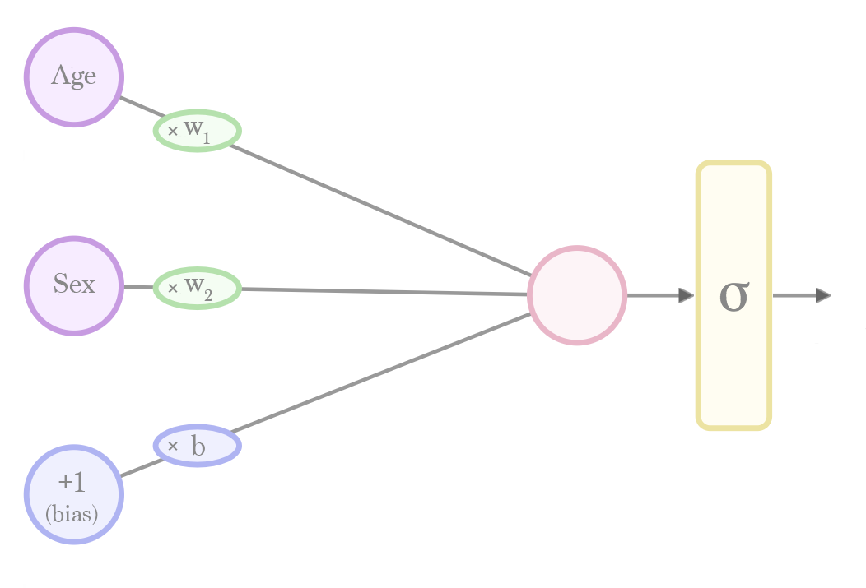
An example with the Titanic dataset
Age | Sex | Survived?
22 | 0 | 0
38 | 1 | 1
26 | 1 | 1
… 891 rows total
Calculate a prediction by plugging in a value for "age" and "sex".
Flow from the left to the right. Before predicting, run a "training" process
Training gives the values for the weights (w) and bias (b).

Slide 46
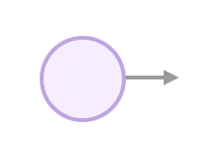
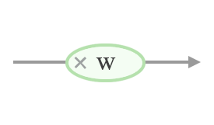
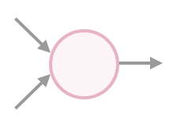
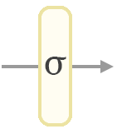
An example with the Titanic dataset

Slide 47
An example with the Titanic dataset
Input neuron is where we plug in an input value (e.g. the age of a person). It’s where the calculation starts. The outgoing connection and the rest of the graph tell us what other calculations we need to do to calculate a prediction.
If a connection has a weight, then the value is multiplied by that weight as it passes through it.
connection_output = weight * connection_input
If a neuron has inputs, it sums their value and sends that sum along its outgoing connection(s).
node_output = input_1 + input_2
Sigmoid squashes the output value of a neuron to between 0 and 1 according to a specific curve.
def sigmoid(x):
return 1/(1 + math.exp(-x))
output = sigmoid(value)

Slide 48
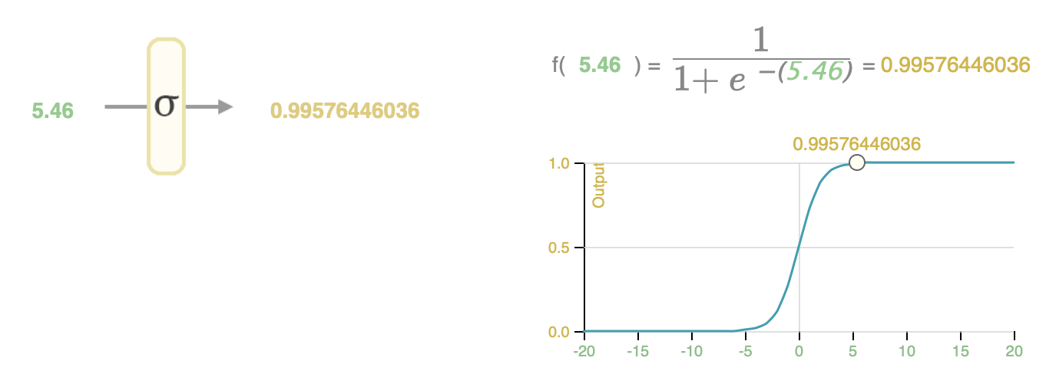
An example with the Titanic dataset
To turn the network’s calculation into a probability value between 0 and 1, we have to pass the value from the output layer through a “sigmoid” formula. Sigmoid squashes the output value of a neuron to between 0 and 1 according to a specific curve.
f(x)= 1/[1+e^(−x)] ​
def sigmoid(x): return 1/(1 + math.exp(-x))

Slide 49
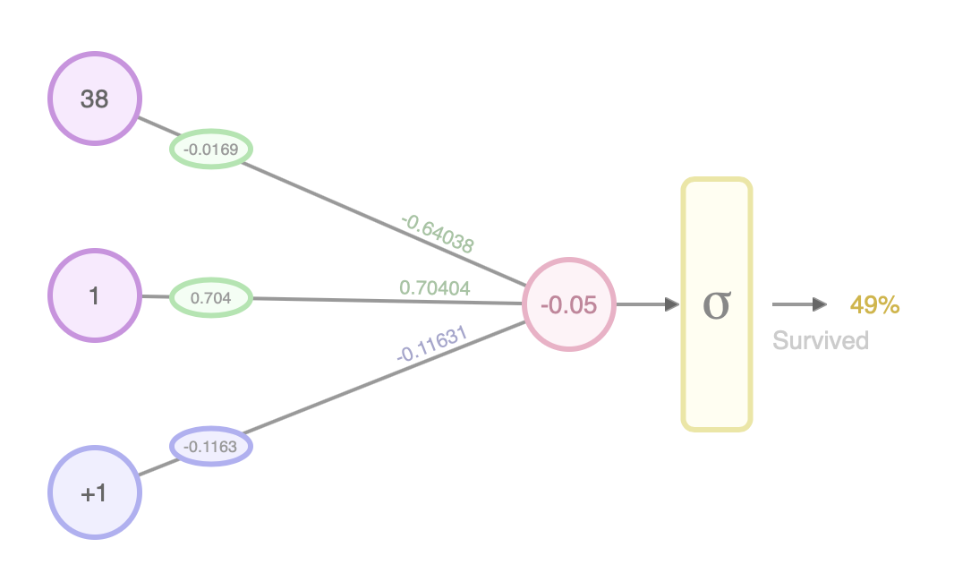
An example with the Titanic dataset
Untrained
Trained

Slide 50
Thank you for
attention!

Slide 51
Sources
https://mattmazur.com/2015/03/17/a-step-by-step-backpropagation-example/
https://swethmandava16.wordpress.com/2017/10/27/backpropogation-for-dummies/
https://mc.ai/a-dummies-guide-to-gradient-descent-and-backpropagation/
https://towardsdatascience.com/illustrated-guide-to-lstms-and-gru-s-a-step-by-step-explanation-44e9eb85bf21?gi=7b2fb431a801
https://towardsdatascience.com/understanding-gru-networks-2ef37df6c9be?gi=3e17099050c1
https://medium.com/m/global-identity?redirectUrl=https%3A%2F%2Fblog.statsbot.co%2Ftime-series-prediction-using-recurrent-neural-networks-lstms-807fa6ca7f
https://machinelearningmastery.com/time-series-forecasting-long-short-term-memory-network-python/
https://jalammar.github.io/visual-interactive-guide-basics-neural-networks/
https://towardsdatascience.com/understanding-gru-networks-2ef37df6c9be
https://jalammar.github.io/feedforward-neural-networks-visual-interactive/
https://towardsdatascience.com/time-series-forecasting-with-rnns-ff22683bbbb0?gi=3f70fc9cf387

